Slide 1
Kern River No. 1 Hydroelectric Project FERC Project No. 1930 Technical Working Group Meeting
REC 1, REC 2, REC 3
July 11, 2023
Please hold, we will begin shortly. Thank you for your patience and for muting your microphone.

Slide 2
Agenda
Safety Moment
Teams Meeting Tips
Welcome and Introductions
Technical Study Plan Schedule
Review Technical Study Plans
Pre-Application Document Availability
Next Steps

Slide 3
Safety Moment

Slide 4
Meeting Tips

Slide 5
Meeting Tips
Please remain on mute unless called on
Turn off camera
Meeting materials are available on Project website www.sce.com/kr1
Consider shutting down other background programs for best meeting audio/viewing quality

Slide 6
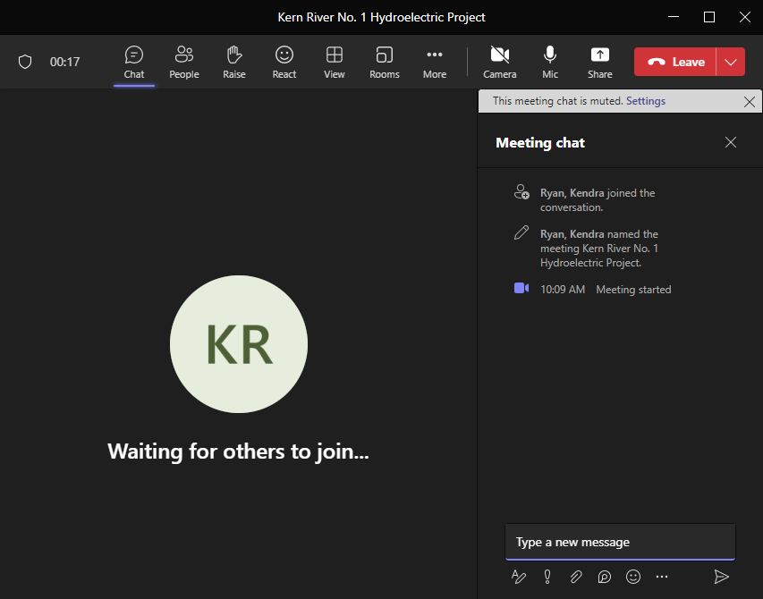
Meeting Tips
To submit a question/ comment in writing:
Utilize the chat feature during the presentation to submit questions/ comments
Questions submitted via the chat feature will be answered at the end of each agenda topic, as time allows

Slide 7
Meeting Tips
To submit a question/comment verbally:
Use the “Raise Hand” feature to indicate you would like to ask a question verbally
Please wait to be called on and then unmute yourself
Introduce yourself (name and affiliation) prior to speaking
Please stay on topic

Slide 8
Welcome and Introductions

Slide 9
Introductions
Team Member | Contact
David Moore, SCE Licensing Manager | dave.moore@sce.com
Patricia Sussman and Dave Martinez, Technical Leads | patricia.sussman@stantec.com; dave.martinez@stantec.com
Ed Bianchi, Stantec Project Director | edward.bianchi@stantec.com
TWG Attendees

Slide 10
Technical Study Plan
Schedule

Slide 11
Technical Working Meeting Schedule
Technical Study Plan | Week Starting
 | 26-June | 3-July | 10-July | 17-July | 24-July | 31-July | 7-Aug | 14-Aug | 21-Aug | 28-Aug | 4-Sep
Aquatic Resources
AQ 1 – Hydrology |  | July 7 10 am- 12 pm |  |  |  | July 31 1-3 pm |  |  | Aug 24 1-3 pm
AQ 2 – Water Quality/Water Temperature |  | 7/7 |  |  |  |  |  |  | 8/25
AQ 3 – Fish Population
Cultural Resources
CUL 1 – Built Environment | June 29 1-3 pm |  |  |  | July 27 1-3 pm |  |  |  |  | Aug 29 1-3 pm
CUL 2 – Archaeology
TRI 1 – Tribal
Land Resources
LAND 1 – Road and Trail Condition Assessment | June 28 1-3 pm |  |  |  | July 26 1-3 pm |  |  |  | Aug 23 1-3 pm
LAND 2 – Erosion and Sedimentation
Recreation Resources
REC 1 – Recreation Facility Condition Assessment |  |  | July 12 1-3 pm |  |  |  | Aug 10 1-3 pm |  |  |  | Sep 6 1-3 pm
REC 2 – Recreation Facility Use Assessment
REC 3 – Whitewater Boating |  |  | 7/12 |  |  |  |  |  |  |  | 9/6
Terrestrial Resources
TERR 1 – Botanical |  |  | July 11 1-3 pm |  |  |  | Aug 8 1-3 pm |  |  |  | Sep 7 1-3 pm
TERR 2 – Wildlife
TWG #1
TWG #2
TWG #3*
* Contingency meeting if needed.
The proposed meeting schedule could be modified based on stakeholder interest and participation.

Slide 12
Draft Technical Study Plans

Slide 13
Draft Technical Study Plans
PAD Appendix C includes 13 Draft Technical Study Plans –
Aquatic Resources
AQ 1 – Hydrology AQ 2 – Water Quality / Water Temperature AQ 3 – Fish Population
Recreation Resources
REC 1 – Recreation Facility Condition Assessment REC 2 – Recreation Facility Use Assessment REC 3 – Whitewater Boating
Cultural Resources
CUL 1 – Built Environment CUL 2 – Archaeology TRI 1 – Tribal
Terrestrial Resources
TERR 1 – Botanical TERR 2 – Wildlife
Land Resources
LAND 1 – Road and Trail Condition Assessment LAND 2 – Erosion and Sedimentation

Slide 14
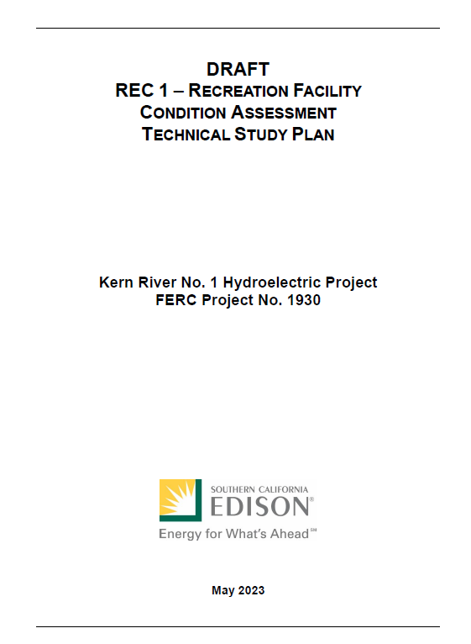
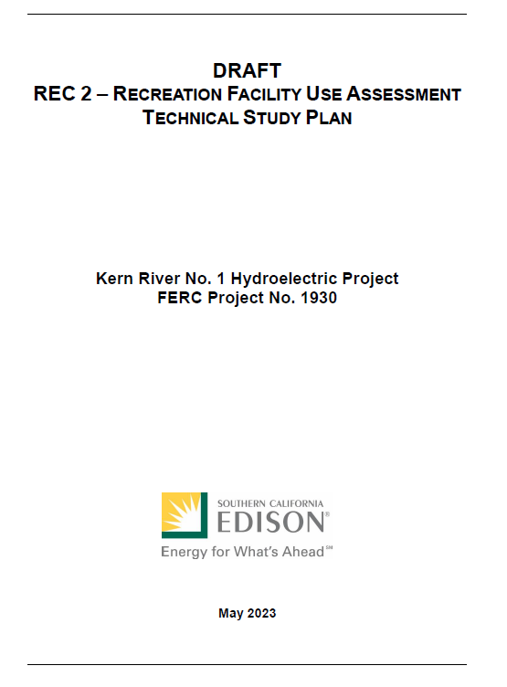
Technical Study Plans – REC 1, 2, 3
REC 1 – Recreation Facility Condition Assessment
REC 2 – Recreation Facility Use Assessment
REC 3 – Whitewater Boating

Slide 15
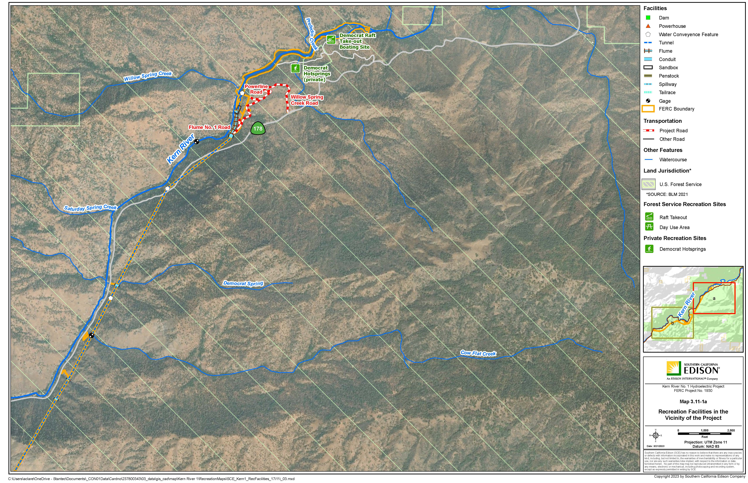

Slide 16
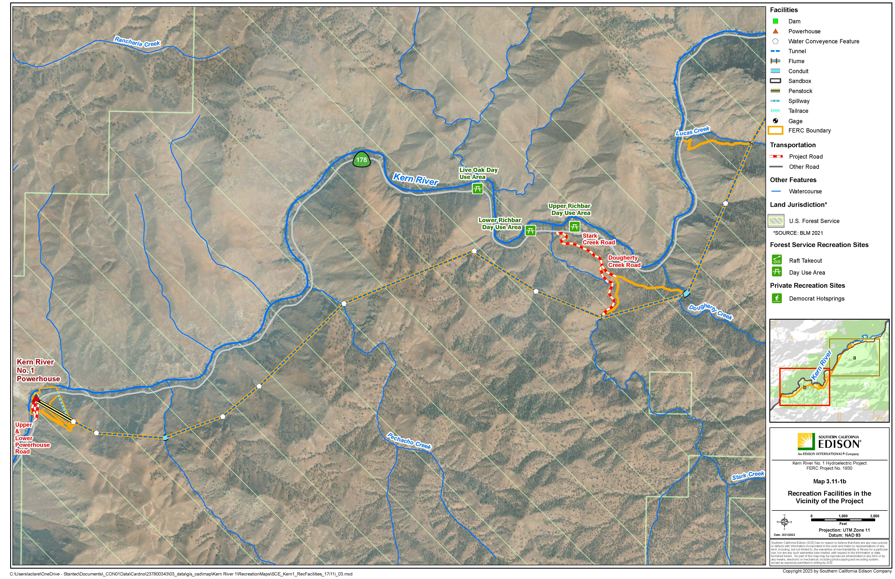

Slide 17
Draft Technical Study Plans
Draft Technical Study Plan Overview
Potential Resource Issue(s)
Project Nexus
Relevant Information
Potential Information Gaps
Study Objectives
Extent of Study Area
Study Approach
Reporting
Schedule

Slide 18
PAD Availability
Public portions of the PAD available here:
SCE’s relicensing website: www.sce.com/kr1
FERC’s eLibrary: https://elibrary.ferc.gov/eLibrary/search
Docket No. P-1930
By appointment at the Kern River No. 3 Powerhouse, located at 15115 Sierra Way, Kernville, CA 93238
Contact Daniel Keverline to schedule at appointment at daniel.keverline@sce.com

Slide 19
Next Steps

