Slide 1
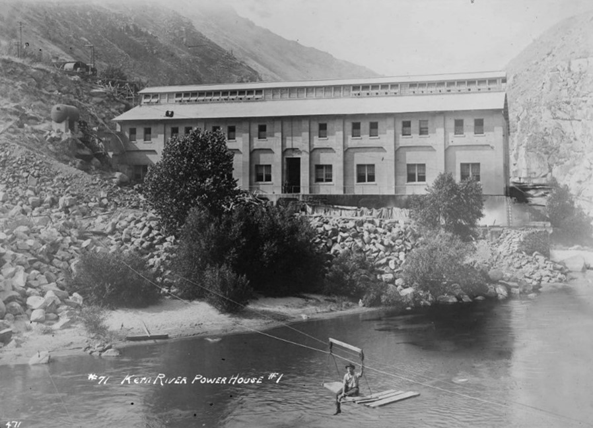

Kern River No. 1 Hydroelectric
FERC Project No. 1930
Technical Working Group Meeting
CUL 1 – Built Environment TSP
CUL 2 – Archaeology TSP
TRI 1- Tribal Resources TSP
June 29, 2023
Please hold, we will begin shortly.
Thank you for your patience and for muting your microphone.

Slide 2
Agenda
Safety Moment
Teams Meeting Tips
Welcome and Introductions
Meeting Purpose and Public/ Confidential Portions of TWG
Review PAD Sections 3.13 and 3.14
Review Draft Technical Study Plans
Technical Study Plan Schedule
Next Steps
Confidential resources Q&A/ Discussion for cultural resource specialists and Tribal representatives only

Slide 3

Safety Moment

Slide 4
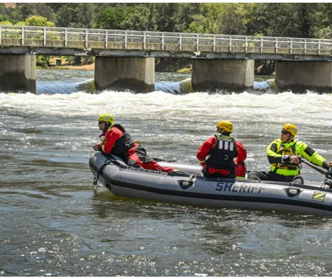
River Safety
Record-high snowpack has led to extreme high-volume flows in the rivers draining the Sierra ​
Water is fast and cold​
Eddy currents and water flow through boulders/rock formations are extremely dangerous​
As temperatures heat up, finding cold water becomes more tempting​
As of June 19, 16 people have drowned in California's rivers this spring NYTimes​
The Merced, Kings, Tule, Kern and Kaweah rivers are currently off-limits for casual recreation, possibly through the summer​
Even in smaller bodies of water or lakes, risk remains

Slide 5

Tips from the Kern River Conservancy and Kern County
Slippery rocks, an unstable shoreline, or a distraction that takes your focus away from the water can cause an accident ​
Keep a close watch on children even if they are far from the water​
Stay on established trails near rapids​
Check river and stream conditions beforehand​
Follow "No Swimming" signs​
Wear a properly fitting life jacket for all river activities
Don’t assume you have the swimming skills to keep you afloat, even the strongest swimmers can drown​
If you fall into the river, do not fight the current. Get into a "lawn chair" position and let the river take you toward the riverbank
Visit http://www.kernriverconservancy.org/river-safety for up-to-date information

Slide 6
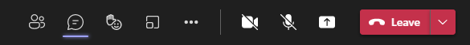
Meeting Tips
Please remain on mute unless called on
Turn off camera
Meeting materials are available on Project website www.sce.com/kr1
Consider shutting down other background programs for best meeting audio/viewing quality

Slide 7
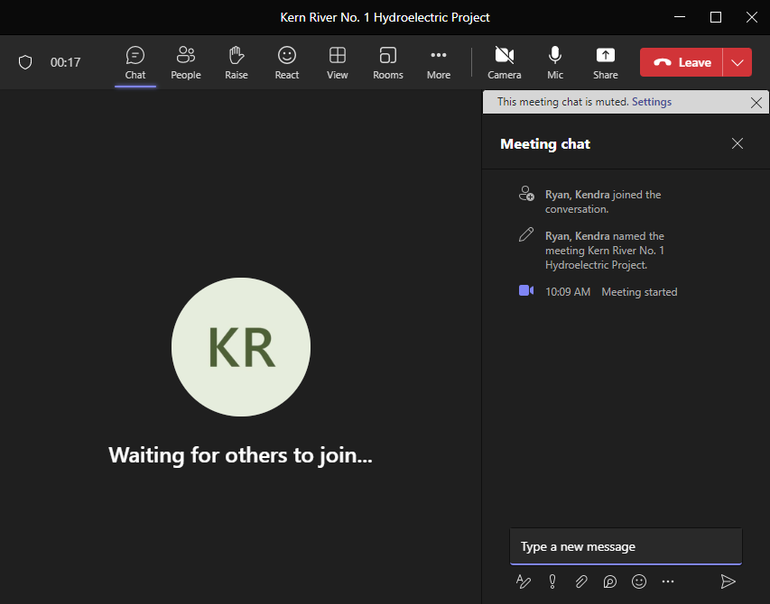
Meeting Tips
To submit a question/ comment in writing:
  Utilize the chat feature during the presentation to submit questions/ comments
  Questions submitted via the chat feature will be answered at the end of each agenda topic, as time allows

Slide 8
Meeting Tips
To submit a question/comment verbally:
Use the “Raise Hand” feature to indicate you would like to ask a question verbally
Please wait to be called on and then unmute yourself
  Introduce yourself (name and affiliation) prior to speaking
Please stay on topic

Slide 9
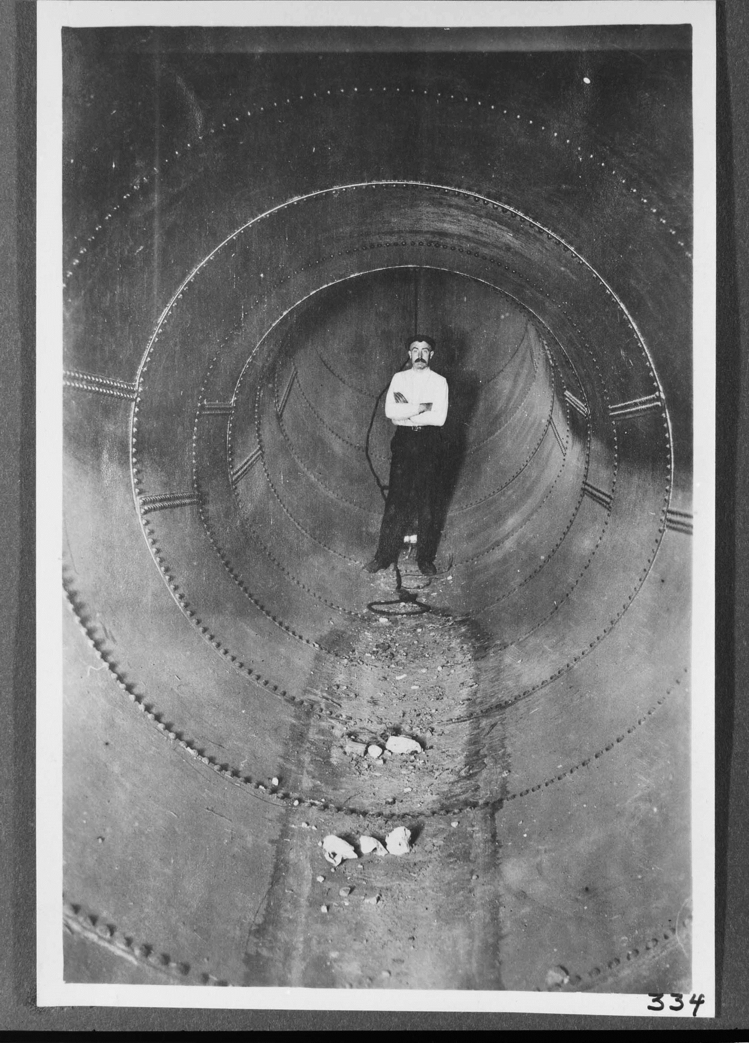
Welcome and Introductions
A man standing inside the completed section of penstock at the Kern River No. 1 Hydro Plant (undated).
Source: SCE Photographs and Negatives, Huntington Digital Library

Slide 10
Introductions
Team Member | Contact
David Moore, SCE Licensing Manager | david.moore@sce.com
Audry Williams, SCE Senior Advisor, Archaeology | audry.williams@sce.com
Crystal West, Cultural Studies Technical Lead | crystal.west@stantec.com
Shelly Tiley, Tribal Resources Technical Lead | tiley@att.net

Slide 11
Meeting Purpose
Public / Confidential TWG

Slide 12
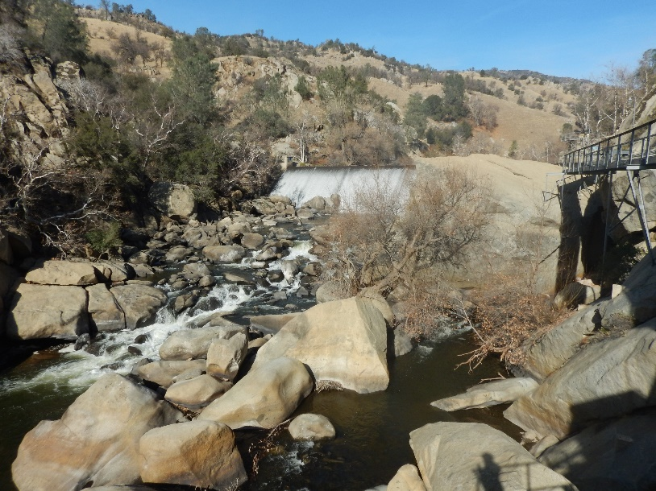
Kern River No. 1 Hydroelectric Project Overview
  FERC License
  FERC Project No. 1930
  Issued June 1998
  30-year license term
  Expires May 31, 2028

Slide 13
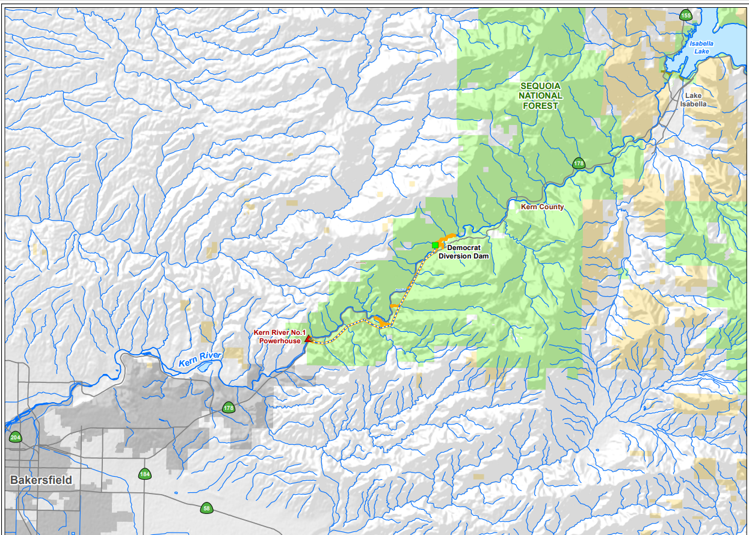
Kern River No. 1 Hydroelectric Project Overview
Project Location
  Western slope of the Sierra Nevada in Kern County
  Approximately 15 miles east of City of Bakersfield
  Project occupies federal lands within the Sequoia National Forest

Slide 14
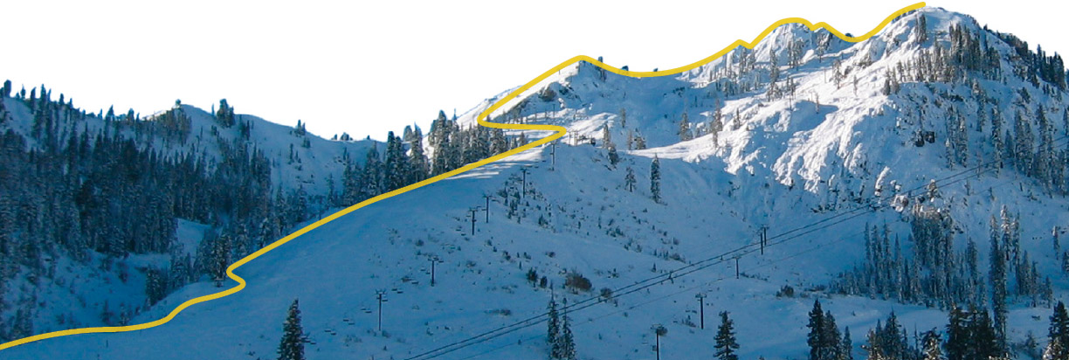
FERC Relicensing Process
New License Order
2028
401 Water Quality
Certification
2027
FERC NEPA Analysis
2026-2028
License Condition
Collaboration 2025-2026
Recommendations, Terms and Conditions
2027
License Application
Submittal
May 2026
Study Plan Implementation
April 2024-April 2025
Study Plan Determination
April 2024*
FERC Scoping
June 2023-November 2023
NOI/PAD Submittal
May 5, 2023
KTT22 AT PALISADES SKI RESORT
* If no study plan disputes.

Slide 15
PAD Availability
  Public portions of the PAD available here:
  SCE’s relicensing website: www.sce.com/kr1
  FERC’s eLibrary: https://elibrary.ferc.gov/eLibrary/search
  Docket No. P-1930
  By appointment at the Kern River No. 3 Powerhouse, located at 15115 Sierra Way, Kernville, CA 93238
  Contact Daniel Keverline to schedule at appointment at daniel.keverline@sce.com

Slide 16
Review Pad Section 3.13

Slide 17
PAD Section 3.13 Cultural Resources
  Proposed APE and Study Area:
  The APE is defined as “the geographic area or areas within which an undertaking may directly or indirectly cause alterations in the character or use of historic properties, if any such properties exist” (36 CFR § 800.16[d]).
  The proposed cultural resources APE for the purposes of study implementation is defined as:
    The area within the FERC Project boundary,
    A 25-foot buffer from centerline of the access trails located outside of the FERC boundary, and
    A 50-foot radius around FERC ancillary facilities such as gauges located outside of the FERC boundary.
  The proposed cultural resource Study Area is a 0.5-mile radius around the proposed APE that was used to capture cultural resource information.
Notes:
Discuss APE/ Study Area in TSP section
A records search of the Study Area was conducted using SCE’s AGOL database, which includes heritage/cultural data from the Forest Service and the CHRIS.
The records search revealed that there have been 82 previous cultural resources studies in the Study Area, 47 of which intersect the APE (Maps 13.3-2a–g; Table 13.3-1). Combined, these investigations resulted in approximately 29.6 percent of the 7,517-acre Study Area and 37.1 percent of the 140-acre APE being previously surveyed or studied.
One of the earliest surveys in the Study Area occurred in 1984 as an inventory and evaluation of cultural resources along Kern River near Democrat Hot Springs (White and Taylor 1984). A total of 19 archaeological sites were identified: 6 historical-period sites and 13 pre-contact sites (White and Taylor 1984). In 1988 the California Department of Transportation (Caltrans) conducted a survey to widen Route 178. The survey evaluated the Kern River No. 1 Hydroelectric Project and determined it to be eligible for the NRHP (Mikesell 1988).

Slide 18
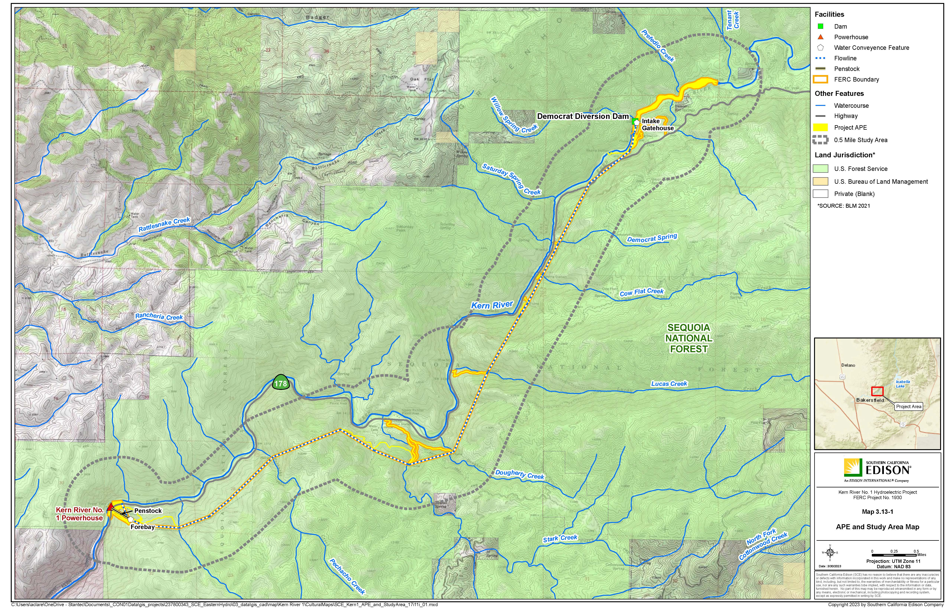

Slide 19
PAD Section 3.13 Cultural Resources
  Known Cultural Resources:
  Total of 41 cultural resources have been previously recorded in the Study Area.
    33 archaeological resources
    8 built environment resources
  Within or adjacent to the APE:
    6 archeological resources:
      3 pre-contact sites with bedrock milling features
      3 historical sites including a gold mine, historic refuse scatter, and remains of a prison work camp
Notes:
None of the 6 archaeological resources within or adjacent to the APE have been evaluated for the NRHP

Slide 20
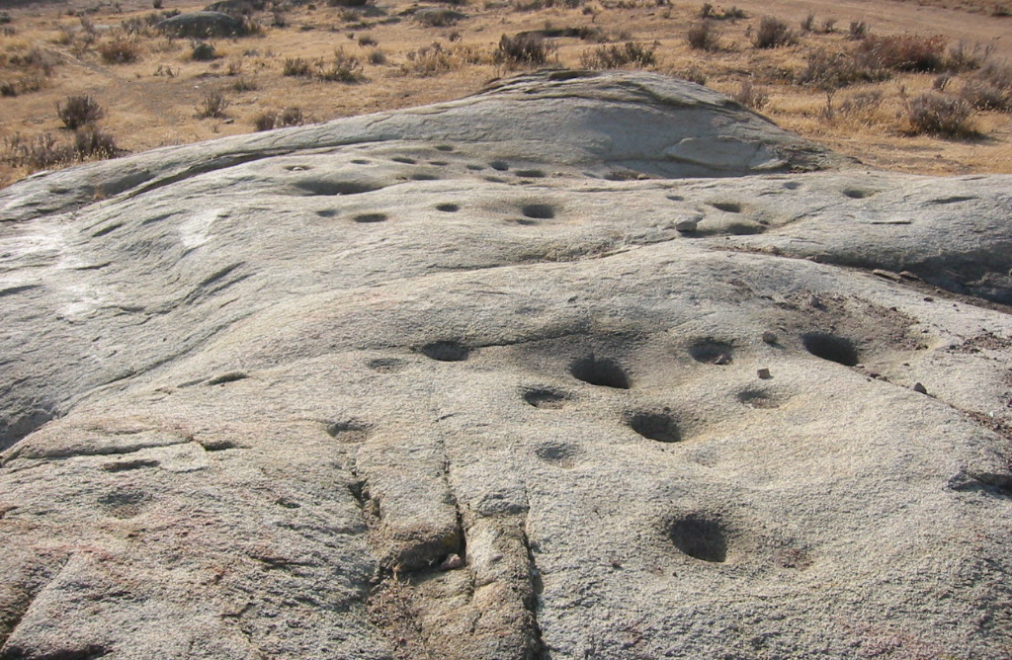
PAD Section 3.13 Cultural Resources
Bedrock milling site Kern County

Slide 21
PAD Section 3.13 Cultural Resources
  Known Cultural Resources: Built Environment
Resource Name | Construction Date | NRHP Evaluation Status
Within and Adjacent to APE
Kern River No. 1 Powerhouse and associated features FS 05-13-54-838 | 1902-1907 | Contributing, KR1HD;Determined Eligible for the NRHP/CRHR (SHPO Ref. No. FHWA881212A)
Democrat Dam P-15-001927H CA-KER-1927H FS 05-13-54-237 | 1902-1907 | Contributing, KR1HD
Kern River No. 1-Los Angles 66KV Transmission Line P-15-010562/P-15-015251 | 1907 | Not Eligible for the NRHP/CRHR (SHPO Ref. No. FERC_2012_1003_001)
Concrete culvert and water basin P-15-015664 CA-KER-8646H FS 05-13-54-862 | 1925 | Unevaluated for the NRHP/CRHR
Concrete culvert P-15-015665 CA-KER-8647H FS 05-13-54-863 | 1925 | Unevaluated for the NRHP/CRHR
Concrete culvert P-15-015666 CA-KER-8648H FS 05-13-54-864 | 1925 | Unevaluated for the NRHP/CRHR
CA-178/Kern Canyon Road P-15-020317 | 1902-1907; 1922-1931 | Recommended Eligible for the NRHP/CRHR
Notes:
Kern River 1 Historic District (KR1HD):11 major components as potential contributors to the historic district including (see Table 3.13-4): intake dam (Democrat Dam [contributing]); intake gate house (contributing); flume (non-contributing); sandbox (contributing); tunnel (contributing); forebay (contributing); penstock (contributing); bypass conduit (non-contributing); powerhouse (contributing), including the turbines (contributing), generators (contributing), exciters (non-contributing), tailrace (contributing), switchboard (contributing), and transformers (outdoor substation racks [non-contributing]); three ancillary buildings including boarding house (office [contributing]), three garages near office (non-contributing) and garage east of office (non-contributing); and a tram (contributing)

Slide 22
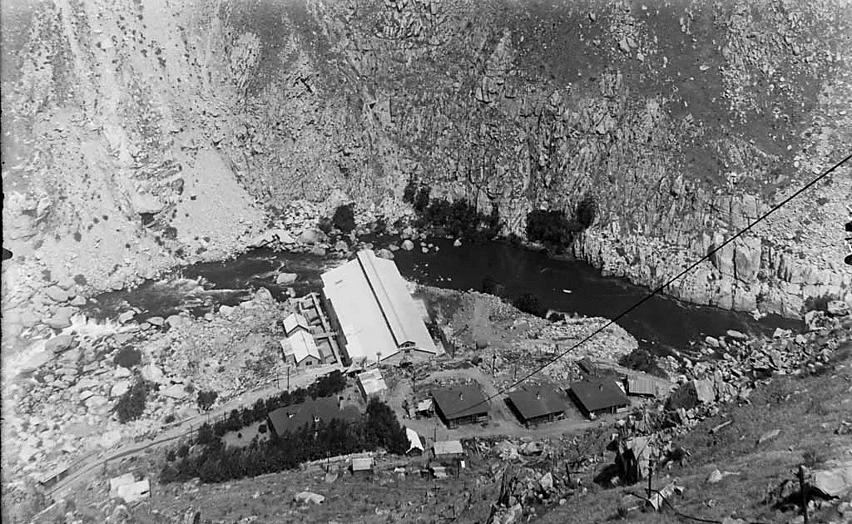
PAD Section 3.13 Cultural Resources
Kern River No. 1 Hydro Plant from tramway (undated).
Source: SCE Photographs and Negatives, Huntington Digital Library

Slide 23
Review Pad Section 3.14

Slide 24
PAD Section 3.14 Tribal Resources
  Proposed APE and Study Area:
  The proposed Tribal resources APE for the purposes of study implementation is defined as:
    The area within the FERC Project boundary;
    A 25-foot buffer from centerline of the access trails located outside of the FERC boundary, and;
    A 50-foot radius around FERC ancillary facilities such as gauges located outside of the FERC boundary.
  The proposed Tribal resources Study Area is a 5-mile radius around the APE. This Study Area is a guide for archival research, development of the historic context and background statements, and general Tribal informant interviews.

Slide 25
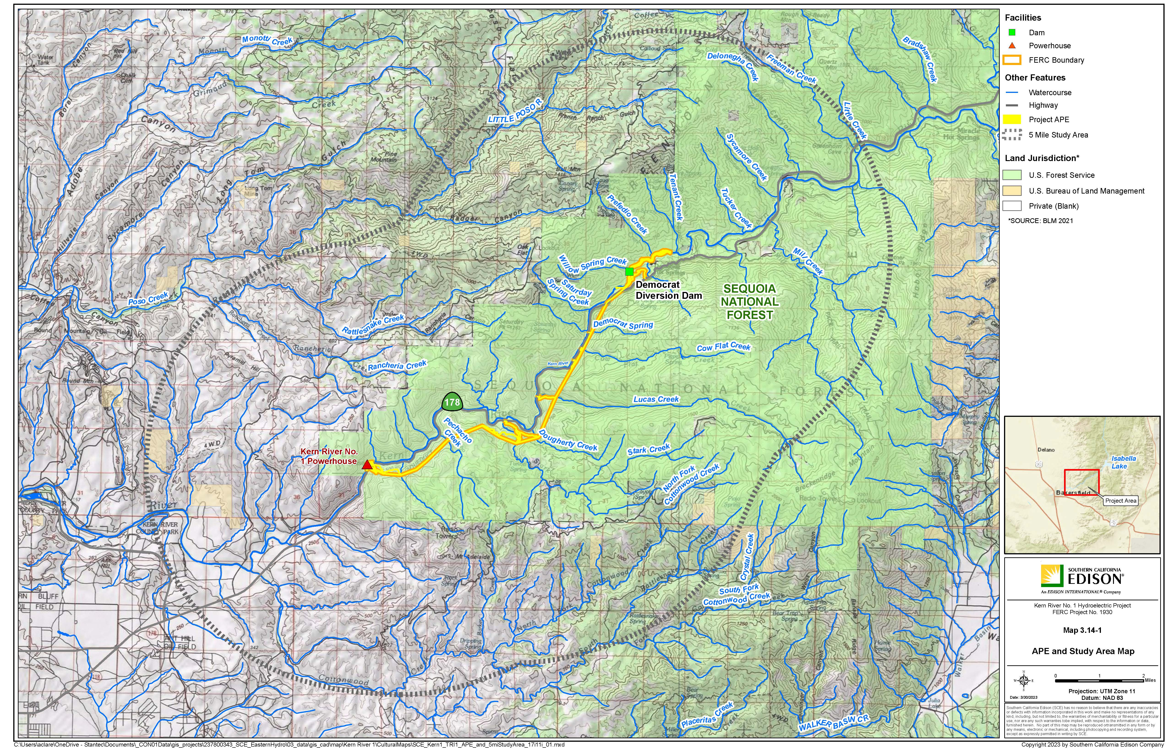
Notes:
No specific Tribal resources or interests have been identified through development of the PAD using readily available, existing ethnographic, ethnohistoric, and other data that may be important to local Tribes.
No TCPs or TCLs have been identified in the proposed APE.

Slide 26
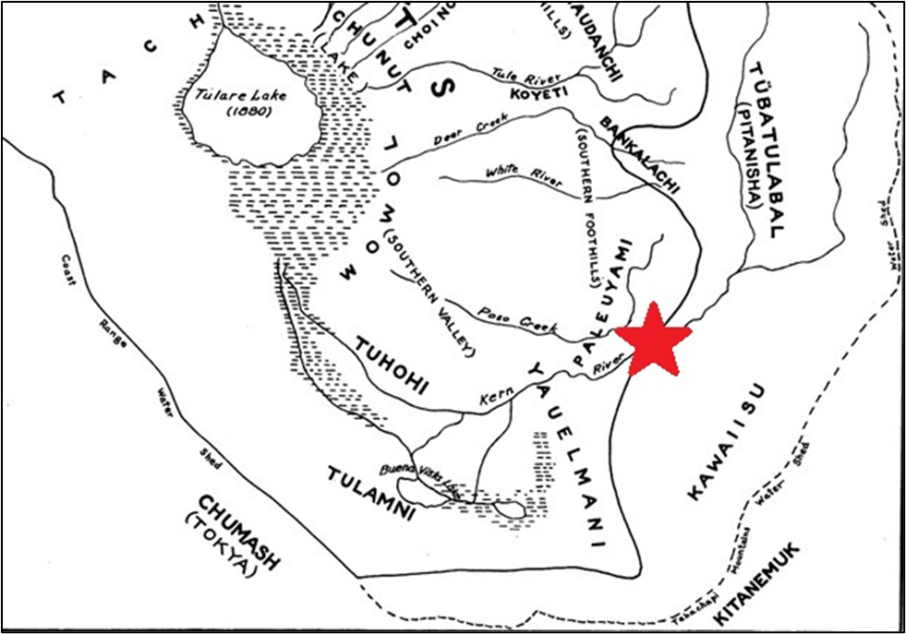
PAD Section 3.14 Tribal Resources
Yokuts and Western Mono Tribes (after Kroeber).
Red star donates general Project location in the lower Kern River (Gayton 1948)

Slide 27
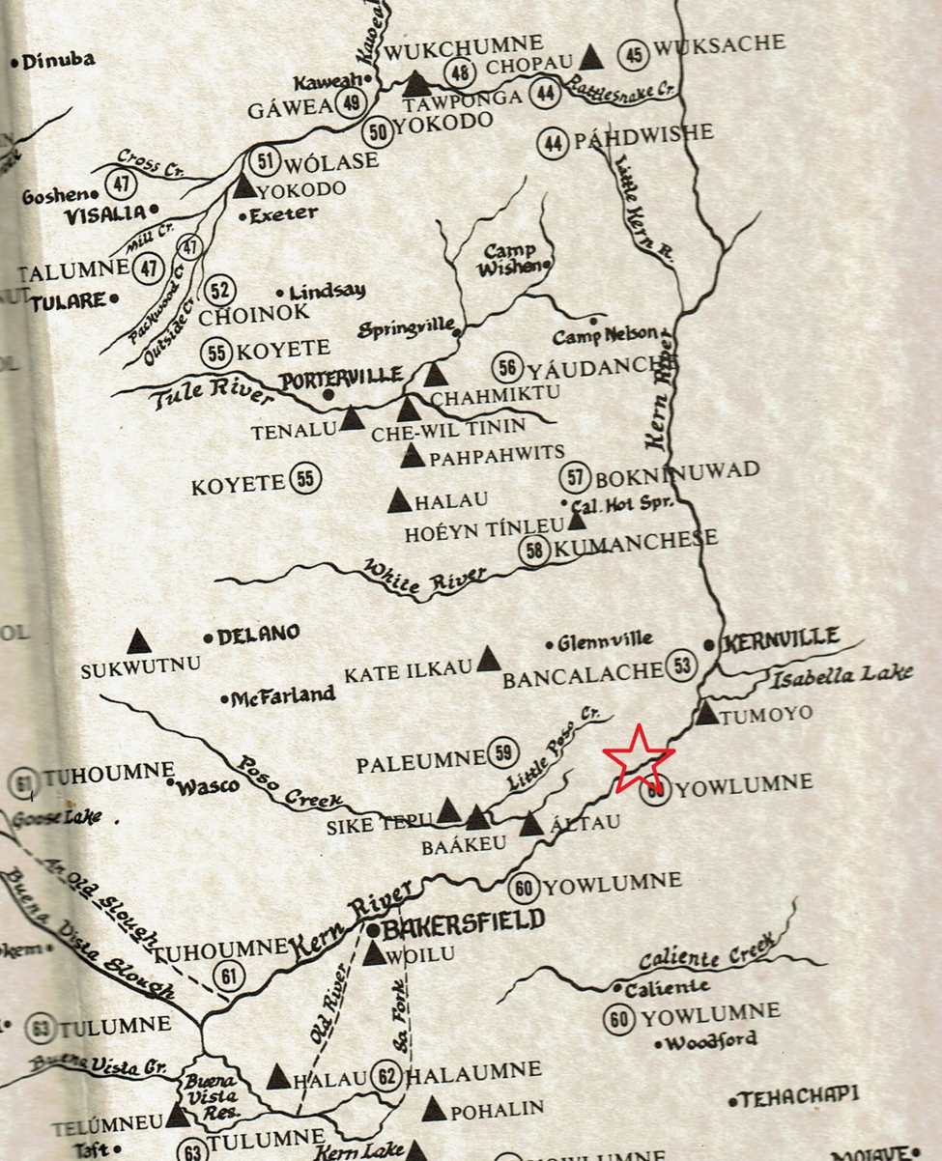
PAD Section 3.14 Tribal Resources
Hamlets and villages within the Kern River Watershed.
Red star denotes general Project location (Latta 2014)
Notes:
Tribal Cultural Places and Values:
Five villages, all west of the Project vicinity, have been documented as Yowlumne places.
While specific places have rarely been identified in the river gorge itself, the multi-group use of Kaw-na Il-kau and adjacent plains and descriptions of the long-distance trade between Kern River groups and eastern Owens Valley Paiute groups and Chumash groups on the Pacific coast to the west demonstrate that the Kern River was an important corridor linking desert, mountain, valley, and coastal groups. The absence of habitation or camp sites is predictable, given the canyon’s steepness, but should not be taken to indicate a lack of use.

Slide 28
PAD Section 3.14 Tribal Resources
  Tribal Lands in the Vicinity of the Project :
  The Tule River Reservation is located north of the Project in Tulare County, and is home to the Tule River Indian Tribe, a federally recognized Tribe. Most members are Yokuts but also include Yowlumne, Wukchumnis, Western Mono, and Tübatulabal. The Tule River Indian Reservation operates the Eagle Mountain Casino.
  The Tejon Indian Tribe is a federally recognized Tribe in Kern County and is currently without Tribal Lands. The Tejon Indian people are of the Kitanemuk nation and share bloodlines with tribes of the region, including bands of the Chumash, Tataviam, Tubatulabal, Paiute, and Yokuts.
  The Tübatulabal are currently a non-federally recognized Tribe but hold allotments (federal [BIA] trust land) in Kern County, east of the Project, none are within the Study Area or APE.
Notes:
No Tribal lands are located within the Project APE.

Slide 29
Draft Technical Study Plans

Slide 30
Draft Technical Study Plans
  Draft Technical Study Plan Overview
  CUL 1 Built Environment
  Potential Information Gaps
  Study Objectives
  Study Approach
  Reporting
  Schedule

Slide 31
Draft Technical Study Plans
  CUL 1 Built Environment Schedule
Date | Activity
June 2023–March 2024 | Meet with the TWG to discuss Draft Study Plan and adequacy of the APE
June 2023–March 2024 | Consult with SHPO regarding adequacy of the APE
January 2024 | Submit Built Environment technical qualifications to Sequoia National Forest for permit
April–December 2024 | Conduct archival research
April–October 2024 | Conduct fieldwork
October 2024–January 2025 | Compile results of research and fieldwork and prepare draft technical memo
January 2025 | Distribute draft technical memo to TWG
February–April 2025 | TWG review and provide comment on draft technical memo
April–June 2025 | Resolve comments and prepare final technical memo
April–October 2025 | Develop Draft HPMP
December 2025 | Distribute final technical memo and Draft HPMP in Draft License Application

Slide 32
Q&A
Open Discussion- Public

Slide 33
Draft Technical Study Plans
  Draft Technical Study Plan Overview
  CUL 2 Archaeology
  Potential Information Gaps
  Study Objectives
  Study Approach
  Reporting
  Schedule

Slide 34
Draft Technical Study Plans
  CUL 2 Archaeology Schedule
Date | Activity
June 2023–March 2024 | Meet with the TWG to discuss Draft Study Plan and adequacy of the APE
June 2023–March 2024 | Consult with SHPO regarding adequacy of the APE
January 2024 | Submit Archaeological technical qualifications to Sequoia National Forest for permit
April–December 2024 | Conduct archival research
April–October 2024 | Conduct fieldwork
October 2024–January 2025 | Compile results of research and fieldwork and prepare draft technical memo
January 2025 | Distribute draft technical memo to TWG
February–April 2025 | TWG review and provide comment on draft technical memo
April–June 2025 | Resolve comments and prepare final technical memo
April–October 2025 | Develop Draft HPMP
December 2025 | Distribute final technical memo and Draft HPMP in Draft License Application

Slide 35
Q&A
Open Discussion- Public

Slide 36
Draft Technical Study Plans
  Draft Technical Study Plan Overview
  TRI 1 Tribal Resources
  Potential Information Gaps
  Study Objectives
  Extent of Study Area
  Study Approach
  Reporting
  Schedule

Slide 37
Draft Technical Study Plans
  TRI 1 Tribal Resources Schedule
April–October 2024 | Conduct Tribal interviews to identify Tribal resources
October 2024–December 2025 | Compile results of data gathered, evaluate Tribal resources, and prepare draft technical memo
December 2025 | Distribute draft technical memo to TWG
February–April 2025 | TWG review and provide comment on draft technical memo
April–June 2025 | Resolve comments and prepare final technical memo
April–October 2025 | Develop Draft HPMP
December 2025 | Distribute final technical memo and Draft HPMP in Draft License Application
January 2025 | Distribute draft technical memo to TWG
February–April 2025 | TWG review and provide comment on draft technical memo
April–June 2025 | Resolve comments and prepare final technical memo
April–October 2025 | Develop Draft HPMP
December 2025 | Distribute final technical memo and Draft HPMP in Draft License Application

Slide 38
Q&A
Open Discussion- Public

Slide 39
Next Steps

Slide 40
Technical Working Meeting Schedule
Technical Study Plan | Week Starting
 | 26-June | 3-July | 10-July | 17-July | 24-July | 31-July | 7-Aug | 14-Aug | 21-Aug | 28-Aug | 4-Sep
Aquatic Resources
AQ 1 – Hydrology |  | July 7 10 am- 12 pm |  |  |  | July 31 1-3 pm |  |  | Aug 24 1-3 pm
AQ 2 – Water Quality/Water Temperature |  | 7/7 |  |  |  |  |  |  | 8/25
AQ 3 – Fish Population
Cultural Resources
CUL 1 – Built Environment | June 29 1-3 pm |  |  |  | July 27 1-3 pm |  |  |  |  | Aug 29 1-3 pm
CUL 2 – Archaeology
TRI 1 – Tribal
Land Resources
LAND 1 – Road and Trail Condition Assessment | June 28 1-3 pm |  |  |  | July 26 1-3 pm |  |  |  | Aug 23 1-3 pm
LAND 2 – Erosion and Sedimentation
Recreation Resources
REC 1 – Recreation Facility Condition Assessment |  |  | July 12 1-3 pm |  |  |  | Aug 10 1-3 pm |  |  |  | Sep 6 1-3 pm
REC 2 – Recreation Facility Use Assessment
REC 3 – Whitewater Boating |  |  | 7/12 |  |  |  |  |  |  |  | 9/6
Terrestrial Resources
TERR 1 – Botanical |  |  | July 11 1-3 pm |  |  |  | Aug 8 1-3 pm |  |  |  | Sep 7 1-3 pm
TERR 2 – Wildlife
TWG #1
TWG #2
TWG #3*
* Contingency meeting if needed.
The proposed meeting schedule could be modified based on stakeholder interest and participation.

Slide 41
Draft Technical Study Plans
  PAD Appendix C includes 13 Draft Technical Study Plans –
Aquatic Resources
AQ 1 – Hydrology AQ 2 – Water Quality / Water Temperature AQ 3 – Fish Population
Recreation Resources
REC 1 – Recreation Facility Condition Assessment REC 2 – Recreation Facility Use Assessment REC 3 – Whitewater Boating
Cultural Resources
CUL 1 – Built Environment CUL 2 – Archaeology TRI 1 – Tribal
Terrestrial Resources
TERR 1 – Botanical TERR 2 – Wildlife
Land Resources
LAND 1 – Road and Trail Condition Assessment LAND 2 – Erosion and Sedimentation

Slide 42
FERC Study Plan Development Process
Applicant includes list of potential studies in PAD (May 2023)
FERC issues Notice of Commencement and Scoping Doc 1 (July 2023)
Stakeholders file comments on PAD/Scoping Doc 1 and study requests (Sept. 2023)
Applicant files Proposed Study Plan (November 2023)
Stakeholders file comments on Proposed Study Plan (Feb. 2024)
Applicant files Revised Study Plan (March 2024)
FERC issues Study Plan Determination (April 2024)
Process takes approximately 10-14 months
60 days
Initial Tribal Consultation Meeting
60 days
Public Scoping Meeting and Site Visit
45 days
90 days
Initial Study Plan Meeting
30 days
30 days
Stakeholders File Comments (15 days)
Formal Dispute Process, if needed

Slide 43
Q&A Discussion
for cultural resource specialists and Tribal representatives only

